Slide 1
STRONGLY CONNECTED COMPONENTS(SCC)

Slide 2
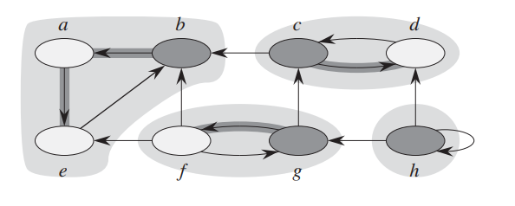
What is an SCC ?
A strongly connected component of a directed graph G(V,E) is a maximal set of vertices C such that for every pair of vertices u and v in C, vertices u and v are reachable from each other.
Example:

Slide 3
Let’s note the following fact:
The graph and its transposed graph(Edges same as G but direction reversed) have exactly same SCCs.
This is because u and v are reachable from each other in G if and only if they are reachable from each other in transpose of G.
We use standard Kosaraju’s algorithm to find SCC from graphs

Slide 4
How to find SCC ?
Apply DFS on given original graph to compute the finishing times for each vertex u(i.e. Push node to stack before returning.)
Compute the transpose G^{T}
Call DFS on G^{T} but consider the vertices in decreasing order of finishing times

Slide 5
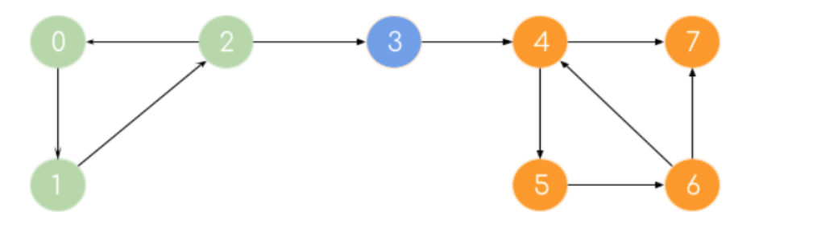
Example run:
Start DFS from node 0 while maintaining the return stack
0
2
3
4
7
1
5
6

Slide 6
0
2
3
4
7
1
5
6
0
2
3
4
7
1
5
6
0
2
3
4
7
1
5
6

Slide 7
0
2
3
4
7
1
5
6
0
2
3
4
7
1
5
6
0
2
3
4
7
1
5
6

Slide 8
0
2
3
4
7
1
5
6
0
2
3
4
7
1
5
6
Now push 7 into the stack following 6,5,4,3,2,1,0
7 | 6 | 5 | 4 | 3 | 2 | 1 | 0

Slide 9
Transpose the graph:
0
2
3
4
7
1
5
6
7 | 6 | 5 | 4 | 3 | 2 | 1 | 0
Now pop 0 from stack and start DFS from 0
Now it will give the SCC 0 1 2
Now as 0,1,2 will be already visited, next DFS will be done on 3
Continue till stack is not empty.

Slide 10
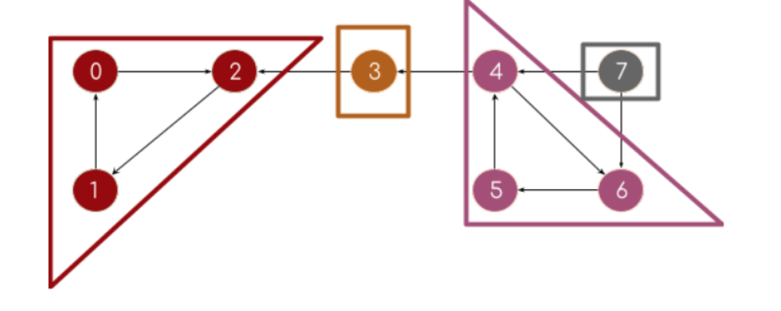
This is the final result:

Slide 11
Time complexity analysis:
As there are two DFS and 1 transpose operation, and DFS takes O(|V| + |E|) as well as transpose.
So the overall time complexity is O(|V| + |E|)

